Slide 1


AI-Powered Student Assistance Chatbot
For
Department of Technical Education
Submitted By:
1. Gunjan Nama
22EJCCS210
2. Ritu Sharma 21EJCCS189
3. Naham Hussain 22EJCCS216
4. Lakshya Jain 22EJCCS213
Submitted to :
Mr.Amit Mithal
(Associate Professor, CSE Dept.)
Dr. Vijeta Kumawat
(Deputy HOD, CSE Dept.)

Slide 2
VISION AND MISSION OF INSTITUTE
Vision of the Institute
To become a renowned center of higher learning, and work towards academic, professional, cultural and social enrichment of the lives of individuals and communities.
Mission of the Institute
To Focus on research and spirit of innovation that will drive academic orientation and pursuit at JECRC.
To Identify, based on informed perception of Indian, regional and global needs, areas of focus and specialization on which the institute can concentrate.
To Undertake collaborative projects that offer opportunities for long-term interaction between academia and industry.
To Develop human potential to its fullest extent so that intellectually capable and imaginatively gifted leaders can emerge in a range of professions.

Slide 3
VISION AND MISSION OF DEPARTMENT
Vision of the Department
To become renowned Centre of excellence in computer science and engineering and make competent engineers & professionals with high ethical values prepared for lifelong learning.
Mission of the Department
M1- To impart outcome based education for emerging technologies in the field of computer science and engineering.
M2 - To provide opportunities for interaction between academia and industry.
M3-To provide platform for lifelong learning by accepting the change in technologies
M4 - To develop aptitude of fulfilling social responsibilities.

Slide 4
COURSE OUTCOMES (COs)
CO1: Generate the report based on the Projects carried out for demonstrating the ability to apply the knowledge of engineering field during training
CO2: Demonstrate Competency in relevant engineering fields through problem identification, formulation and solution

Slide 5
CONTENTS
Introduction
Problem Statement
The Challenge
Our Solution
Key features
Technology we used
Screenshoot
Why we use web applications
Future Scopes
References

Slide 6
Introduction
In recent years, the utilization of Artificial Intelligence (AI) technologies in teaching and learning has evolved and computerized learning into more dynamic, tailored, and easier systems to suit a user’s preference. Among such breakthroughs is the introduction of AI driven chatbots which have become a notable development in the improvement of student services and educational assistance systems.
This research is based on the design, development, and application of an AI student assistance chatbot for the Department of Technical Education. The main objective is to answer frequently asked questions by students, provide academic and administrative assistance, and enhance the communication between students and faculty members.
In most cases, the technical education departments have problems related to large volumes of student queries concerning the admission and enrollment processes, course details, examination dates, results, and even career guidance for learners nearing the completion of their programs.

Slide 7
Problem Statement
1. High Query Volume & Limited Staff :-
Thousands of students contact the Department of Technical Education (DTE) daily; human staff can’t answer everyone promptly.
2. Slow, Inconsistent Response Times:-
Manual email/phone handling leads to delays and varied answer quality, hurting student satisfaction.
3. 24×7 Availability Gap :-
Students raise doubts after office hours and during exam/admission peaks, but support desks close at 5 p.m.
4. Information Fragmentation :-
Details on admissions, scholarships, exam results and grievances are scattered across multiple websites, PDFs and circulars.

Slide 8
The Challenge
Understanding Diverse, Domain‑Specific Queries :-
Students ask in mix of Hindi/English, slang, typos, course codes, policy jargon; intent classification and entity extraction must be robust and up‑to‑date.
2. Data Availability & Quality :-
Accurate responses require clean, structured datasets (admission rules, fee tables, scholarship criteria) that are often scattered across PDFs, circulars, and legacy portals.
3. Multilingual & Code‑Mixed NLP :-
Rajasthan’s student population switches between English, Hindi and local dialects; models must handle transliteration (e.g., “scholarship kab milegi?”).
4. Scalability & Peak‑Load Handling :-
Admission‑season traffic spikes 10‑20×; backend should autoscale on AWS/Azure while keeping latency <1 s.

Slide 9
Our Solution
AI‑powered virtual assistant for DoTE students :-
• 24×7 instant, accurate responses
• Cuts admin workload & boosts student satisfaction
2. End‑to‑End Workflow :-
• User query→ NLP engine → Intent detection→Knowledge base lookup → Response
• Continuous learning loop from feedback
3. Core Capabilities :-
• Admissions FAQs
• Course & syllabus info
• Scholarship guidance
• Event & result alerts
• Grievance redressal routing

Slide 10
Key Features
1. Natural Language Processing Capabilities :-
Advanced language comprehension to interpret student questions
Context-aware processing that remembers conversation history
2. 24/7 Automated Response System :-
Instant responses regardless of time or day
No queues or waiting periods for basic information
3.Comprehensive Information Coverage:-
Admission processes and requirements
Course details, syllabi, and eligibility criteria
4.User-Friendly Interface:-
Web-based interface compatible with all browsers
Mobile-responsive design for on-the-go access
5.Security and Privacy Protection:-
End-to-end encryption for all communications
Compliance with data protection regulations

Slide 11
Technology We Used
Frontend: React.js
Backend: Django/Flask REST
AI/NLP: OpenAI GPT, SpaCy, TensorFlow
DB: PostgreSQL
Infra: AWS EC2 + RDS, Docker, GitHub CI/CD

Slide 12
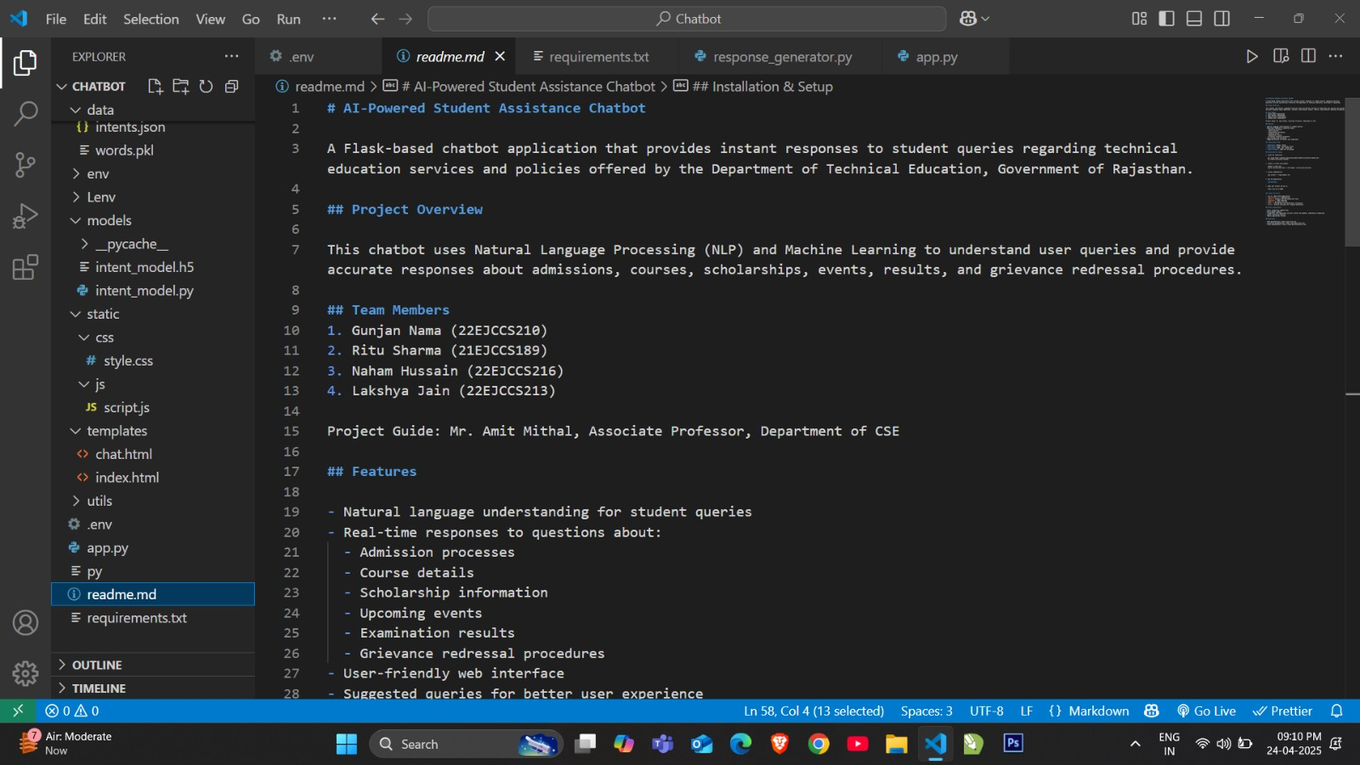
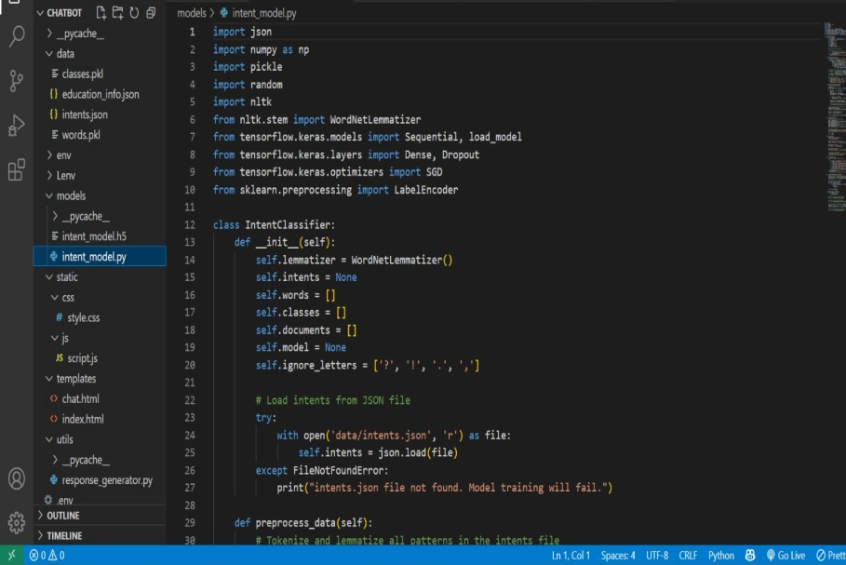
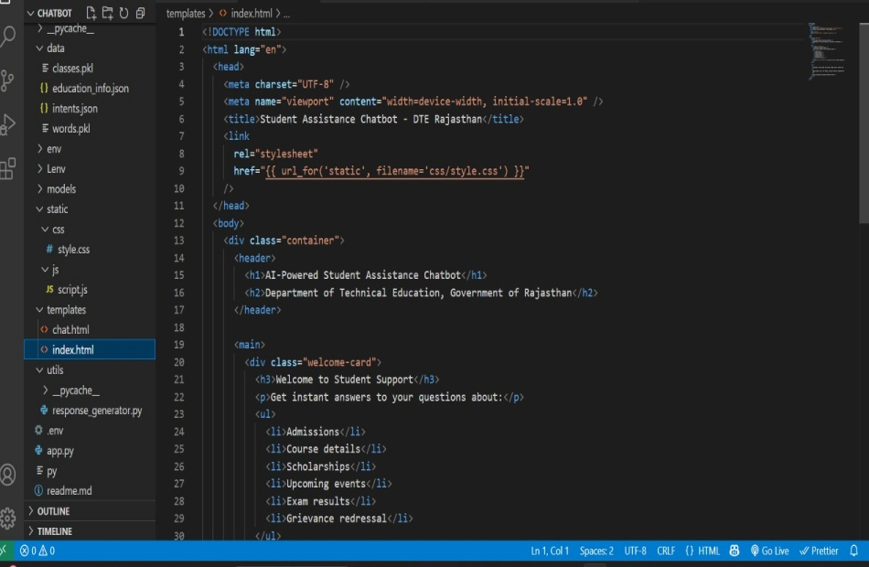
screenshot

Slide 13
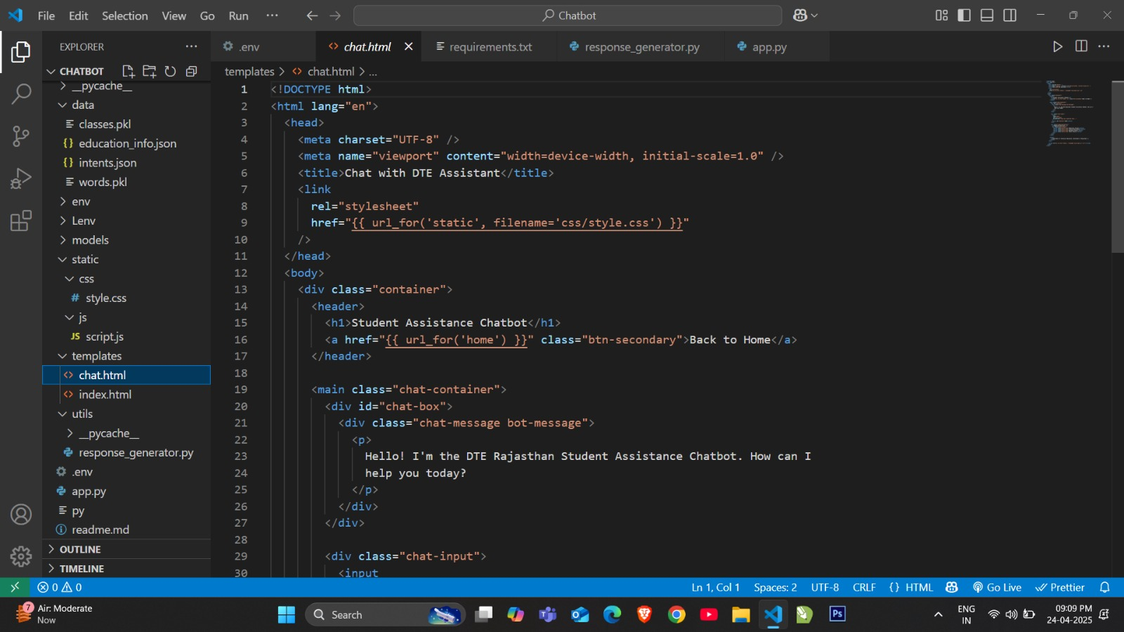
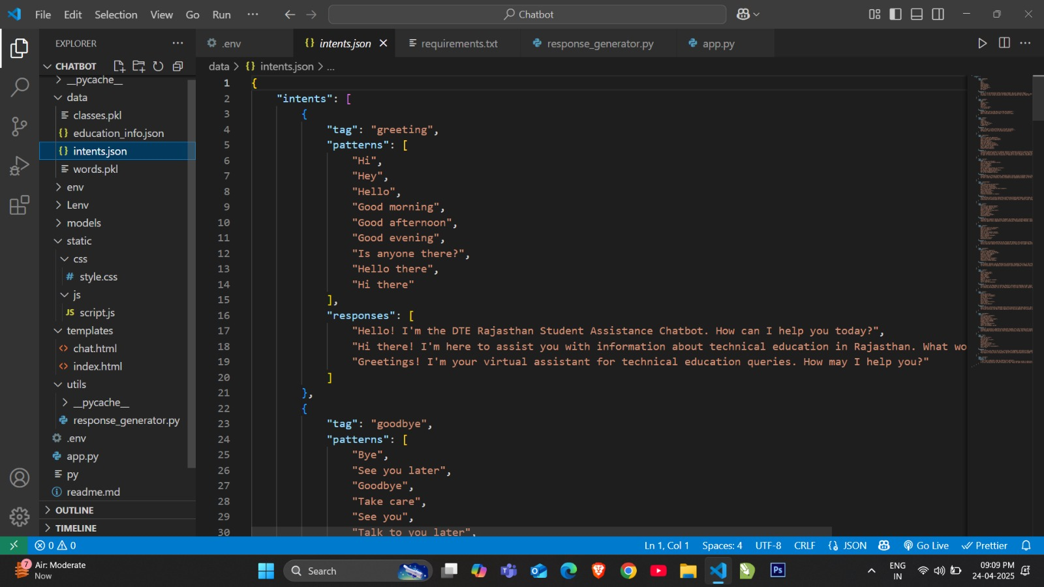

Slide 14
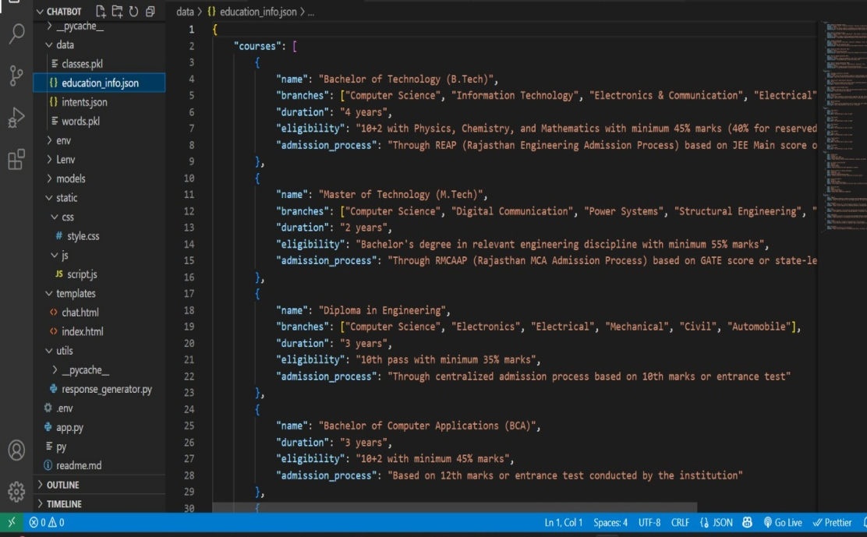
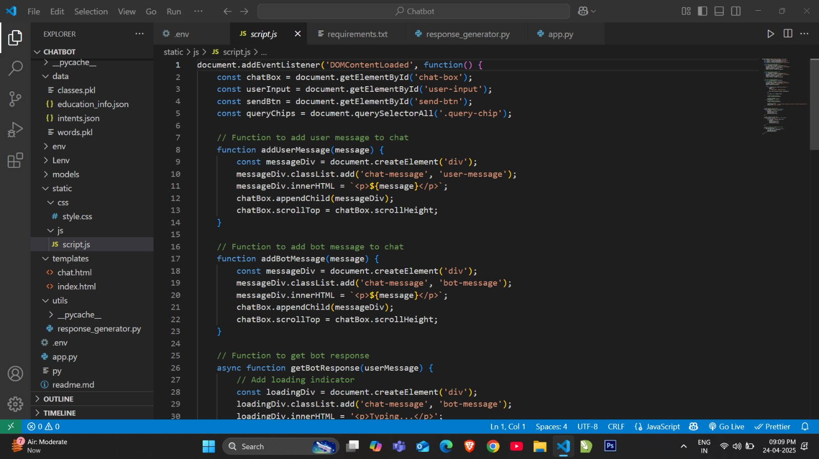

Slide 15
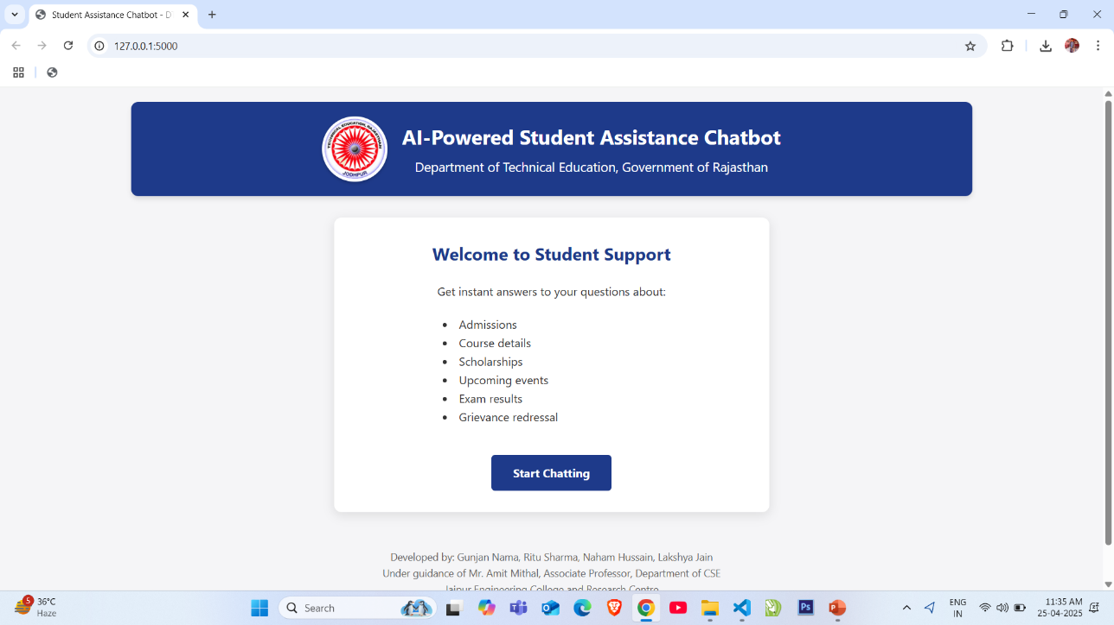
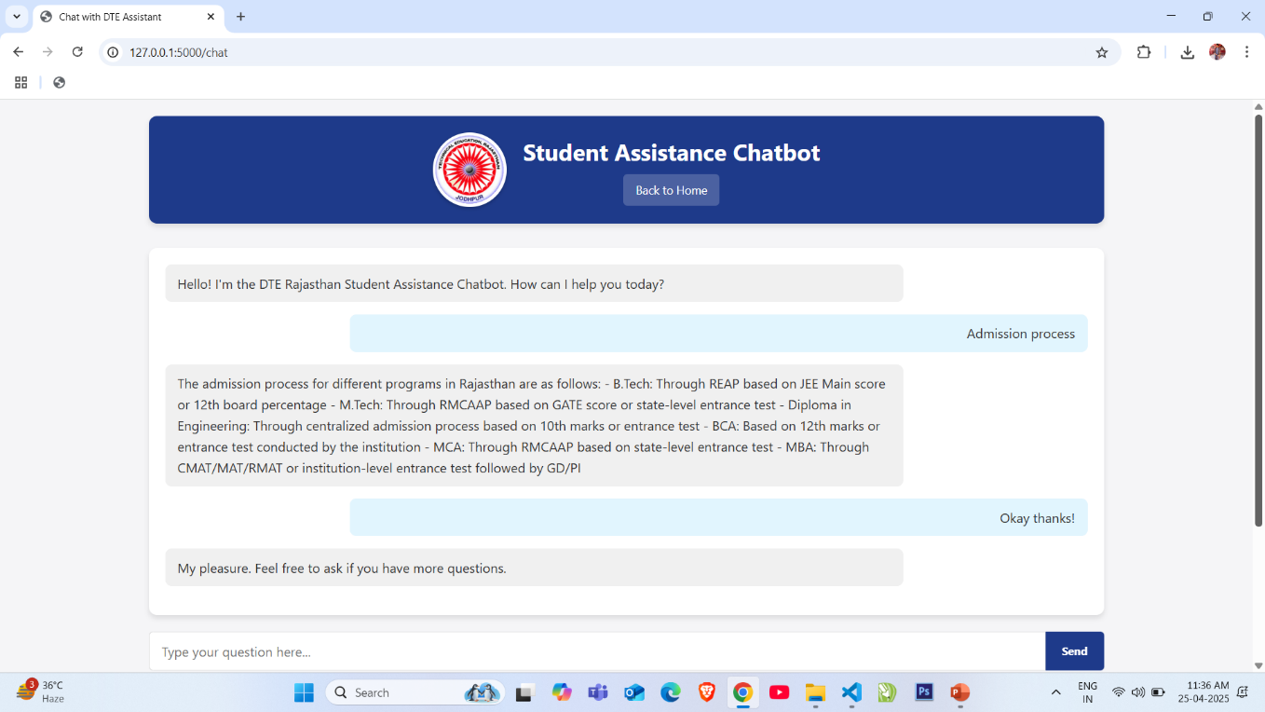
User Interface of Chatbot

Slide 16
Why We Use Web Applications
Runs on any device/browser—zero install
Centralized updates & A/B testing
Dept. portal SSO integration
Responsive & WCAG 2.1 accessible
Cloud auto‑scaling for peak loads

Slide 17
Future Scopes
1.Voice Recognition Integration :-
Implement speech-to-text capabilities to allow students to interact with the chatbot through voice commands.
2. Multilingual Support :-
Expand the chatbot to communicate in regional languages like Hindi, Marwari, and other local dialects prevalent in Rajasthan.
3.Online Fee Payment Integration :-
Connect the chatbot with payment gateways to facilitate fee payments, reducing the need for physical transactions.
4. Examination Services:-
Develop features for exam scheduling, admit card distribution, and instant result checking.
5. Career Counseling Module:-
Incorporate AI-driven career guidance based on student performance, interests, and market trends.

Slide 18
References
1. Adamopoulou, E., & Moussiades, L. (2020). Chatbots :-
History, technology, and applications. Machine Learning with Applications, 2, 100006.
2. Cui, L., Huang, S., Wei, F., Tan, C., Duan, C., & Zhou, M. (2021). SuperAgent :-
A customer service chatbot for e-commerce websites. In Proceedings of the 59th Annual Meeting of the Association for Computational Linguistics.
3. Bii, P. K., & Too, J. K. (2021). Impact of AI chatbots in educational institutions :-
A systematic review. International Journal of Computer Applications, 174(13), 45-50.
4. Winkler, R., & Söllner, M. (2022). Unleashing the potential of chatbots in education :-
A state-of-the-art analysis. Journal of Computer Assisted Learning, 38(3), 878-892.
5. Kumar, A., & Singh, R. (2023). Implementing NLP-based chatbots for government services :-
Case studies and best practices. Government Information Quarterly, 40(1), 101812.

Slide 19
Thank you

